Slide 2
Bulk SMS and Email Delivery System
Submitted to:
Department of Computer Science and Engineering

Slide 3
Supervised by: Prof. Shivashankar Rajput Assistant Professor CSE AITR
Team Members
1. Aryan Dame
2. Anurag Chauhan
3. Anirudha Khode
4. Aditya Trivedi

Slide 4
Project Presentation Outline
Abstract
Introduction
Problem Statement
Survey of Existing Systems
Project Objectives
Requirement Analysis
Designs/UML Diagrams
Solution Proposed
The Outcome Discussion
Conclusions and Limitations

Slide 5
Abstract
Bulk emailing and messaging refers to the distribution of a large number of emails and messages for delivery to mobile phones and computer systems. It is utilized by media companies, enterprises, banks for marketing and fraud control, and consumer brands for a variety of purposes, including entertainment, business, and mobile marketing.
SMS (Short Message Service) and email (electronic mail), as text messaging services, offer the convenience of instant communication by allowing the sending of emails and text messages to anyone, anytime and anywhere. The bulk email and SMS system enhance this capability by enabling the efficient sending of multiple emails and messages to the desired recipients with reliability.

Slide 6
Introduction
A bulk SMS or email service that can effectively communicate information to a large audience in a brief period of time is necessary. It may encompass important alerts, warnings, and news that must be delivered to all citizens of a country simultaneously.
This app will permit the sending of bulk emails and SMS to users in a single transmission using SMTP or other technology, also ensuring that all users receive a notification on their mobile devices.

Slide 7
The Problem Statement
Information sharing is a major factor for development in the country. It is a time taking process to share information to all the citizens of the country through media and newspaper.
In this modern generation almost everyone has a mobile phone in their hand. We can use this opportunity to share information directly to them through SMS or email.
This will save time and money and information can be shared with a larger community within short time duration. Also such service can be used to repeatedly send SMS in case of emergency situations.

Slide 8
Survey of Existing Systems
Plivo
Description: Plivo’s cloud communication platform offers a simple, fast, and scalable way for companies to modernize their business communications. Plivo’s API platform lets businesses quickly incorporate voice and text messaging capabilities (both SMS and MMS) into their own applications, and it offers SIP truncating and phone number rental services.
Advantages:
Ease Of Integration
API Call Speed
Communication Varieties
Documentation Available
Disadvantages: It is expensive and majorly meant for business purposes
Reference link: https://www.plivo.com

Slide 9
Survey of Existing Systems
Atomic SMS Sender
This is an online application that allows users to send bulk SMS from their phones or computers. The application can be used to send SMS to over 200 countries and supports over 700 mobile operators.
Advantages:
Easy contact management
Can schedule messages at anytime
Live online training and documentation are readily available
Offers unsubscribe feature for the audience to make them feel privileged
Disadvantages:
2-way messaging is not possible
MMS and mobile coupons are also not possible
Sometimes SMS doesn’t get delivered on time
Gaps Identified: Lack the ability to personalize emails, making them appear generic and lacking in engagement.
Reference Link: https://sourceforge.net/software/product/Atomic-SMS-Sender/

Slide 10
Survey of Existing Systems
My SMS Mantra
My SMS Mantra is a free software for sending bulk SMS that enables the user to send SMS online, using an Excel plug-in. All you need is to download and install the Excel plug-in and then stay connected to your clients/customers via SMS.
Advantages:
Seamlessly interfaces with other applications through its API
Easy to set up with no hidden costs
Has free technical support
Allows 2-way messaging thanks to its Mantra Communicator
Disadvantages:
The word limit for SMS messages is too short
Might lose data put in the software if you face network issues
Gaps Identified: The pricing depends on the kind of SMS to be sent – whether it is a transactional or a promotional SMS.
Reference Link: https://www.mysmsmantra.com

Slide 11
Project Objectives
We require a mobile/web app that will enable the sending of bulk emails and SMS to users in a single transmission using SMTP or other technology, ensuring that all users receive a notification on their mobile devices.
Additionally, features such as log generation, notification of failed SMS and/or email delivery, scheduling of SMS/emails, a scheduler alert/notification system, creation of users with different roles and responsibilities, read/unread status, the ability to import contact details from Excel worksheets, and customization of emails with the recipient's name should also be included.

Slide 12
Requirement Analysis
Hardware Requirements:
Processor: Intel core i3
RAM: 2GBs
Hard Disk: 80 GBs (Memory Consumption: 5 MB while in use)
Software Requirements:
Operating System: Windows 7
Frontend: Python Tkinter
Backend: MySQL

Slide 13
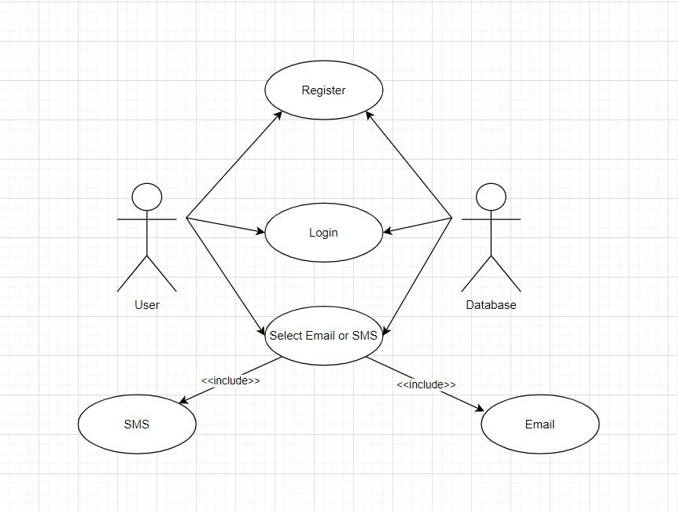
Designs/UML Diagrams
Use Case UML Diagram

Slide 14
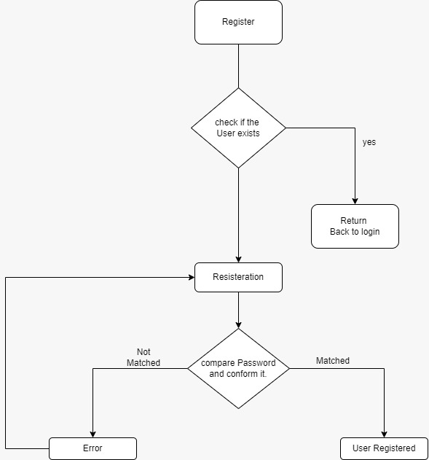
Designs/UML Diagrams
Registration Flow Chart

Slide 15
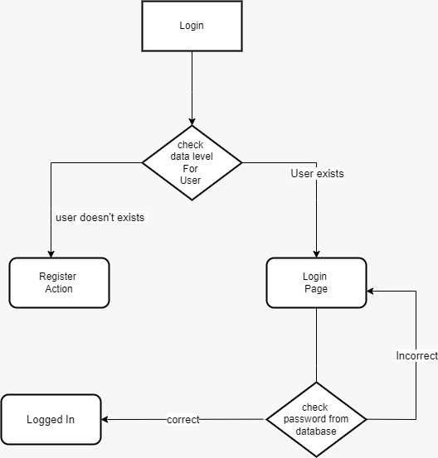
Designs/UML Diagrams
Login Flow Chart

Slide 16
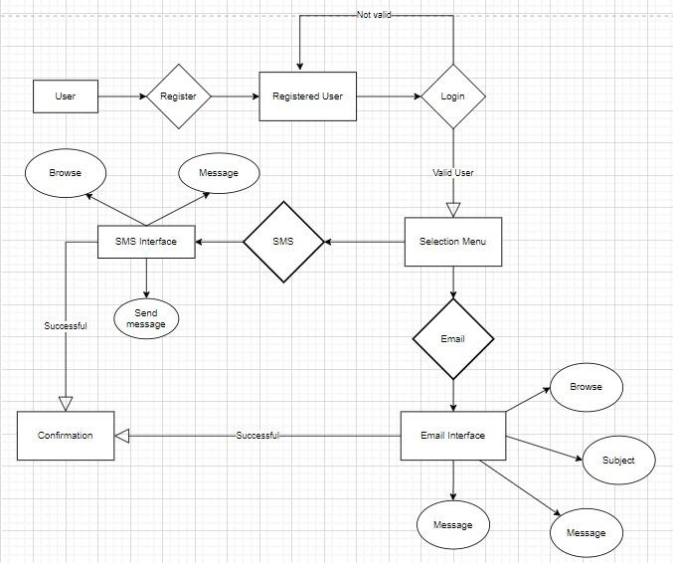
Designs/UML Diagrams
E-R Diagram

Slide 17
Solution Proposed
The final deliverable will be an application made using Python Tkinter as the front end and MySQL as the back end.
This project is very useful for the study of Python and the interaction between SMS and Computer programs.
This project report consists of the basic idea of Bulk Email & SMS receiving and sending through a personal computer. This project basically supports to busy people who want to save time.
We have provided easy interaction for users for adding new contact names & contact numbers.
Also we can store information about that person. We have provided a MySQL database for storing information about the person.

Slide 18
The Outcome Discussion
While SMS (Short Message Service), a text messaging service, elicits the appeal of instantaneous communication by using mobile technology to send a text message to anyone anytime and anywhere, the bulk SMS system has expanded that capability of SMS by implementing the ability to easily send multiple SMS messages to intended recipients with reliability. The advantages of bulk SMS can be applied in schools and universities to further develop classroom interactions and set up a virtual community as a public relations system. Lecturers can conduct mobile quizzes in many question forms with their students via SMS.

Slide 19
Conclusion and Limitation
This project is widely used in organizations, colleges, banking, companies, E-Commerce, Market News, Government & Public Utilities, Logistics, Media & Entertainment, Travel & Tourism Industry, etc. Alert your customer/user about the new updates of organizations/colleges. In Logistics, it is used to send shipping updates, invoices, bills, tracking detail web URLs, and much more via SMS. In Media & Entertainment, it is used to invite the audience to an FM/TV show or ask the audience to vote for their favorite contestants in your reality show. and it is also used in Travel & Tourism Industry to become a travel buddy of your customer by sending all the itineraries and travel routes via an SMS to make their journey more hassle-free.
In all, this project has multiple use cases and therefore it proves to be one of the significant solutions to real-world communication problems.
Limitations:
SMS Character Limit
Delayed Messages
Server Problem

Slide 20
Acknowledgment
We acknowledge that information provided above is true to the best of our knowledge.
We would like to express our deepest gratitude to Prof. Shivshankar Rajput for their guidance and helping us complete our project.

Slide 21
THANKS

